Slide 1
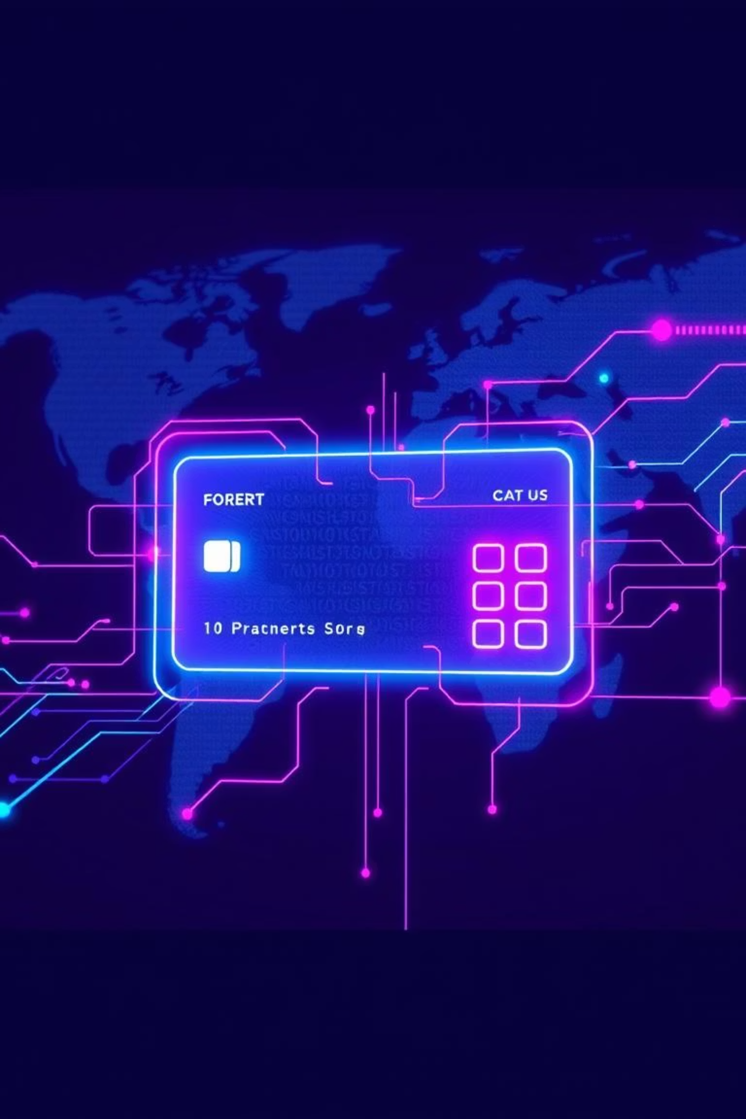

Title of the Project
UPI Transaction Data Analysis
This project focuses on analyzing UPI transaction data to uncover patterns, trends, and insights in digital payment usage across India.
Based on the 2022-2024 dataset
by Jagruti Pandey

Slide 2
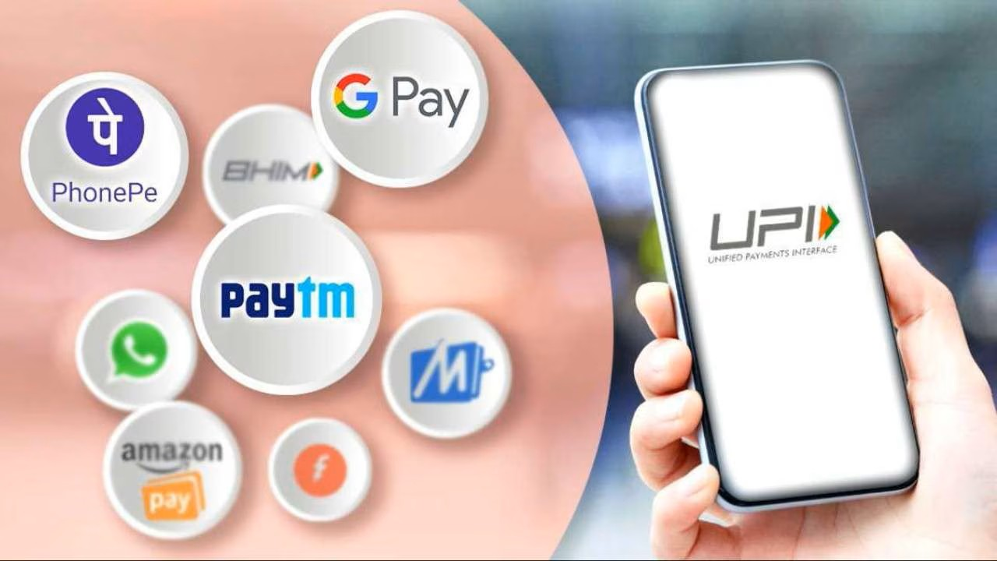
Objectives
The main objectives of this UPI Transaction Data Analysis are:
Understand Transaction Patterns
Analyze transaction volumes by time, location, user, and device to identify common trends.
Measure Success and Failure Rates
Identify how many transactions fail and explore possible reasons or patterns behind failures.
Track Usage by Bank, Merchant, and Device
Evaluate which banks, merchants, and device types are most commonly used for UPI transactions.
Analyze User Behavior
Examine user activity by gender, city, transaction type (P2P vs P2M), and day of the week.
Visualize Key Metrics
Create interactive charts and dashboards to present findings in a simple and meaningful way using tools like Python and Plotly.
Support Data-Driven Decisions
Provide insights that can help fintech companies, digital payment platforms, or researchers make informed decisions.

Slide 3

Key Metrics
Total Transactions Amount: 19872274.03
Total Number of UPI Transactions:20000
Number of Transactions Failed:4000
Number of Transactions Success:16000
Number of Males: 10021
Number of Females: 9979

Slide 4
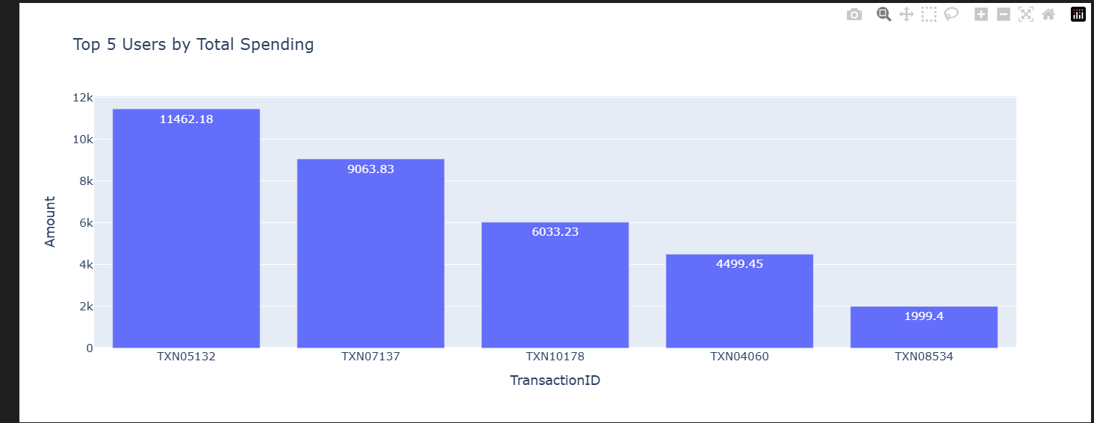
Top 5 Users by Total Spending
Analyze individual transaction data to calculate the total amount sent per user
Sort and filter to identify the top 5 high-value senders
Understand sending behavior and frequency

Slide 5
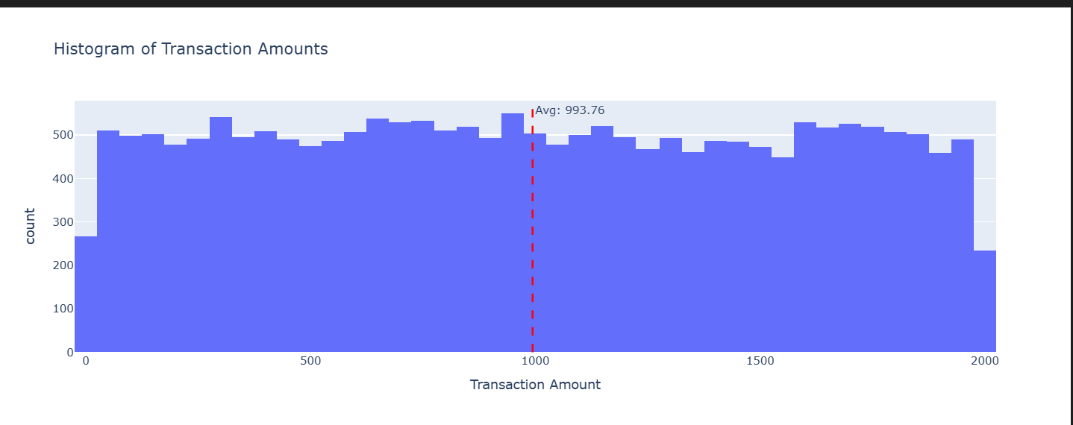
Histogram of Transaction Amounts
Understand Usage Trends: Analyze growth in transaction volume and value over time.
Identify Top UPI Apps: Compare the performance of apps like PhonePe, Google Pay, and Paytm.
Find Top Performing States: Rank states by total transactions and value sent/received.

Slide 6
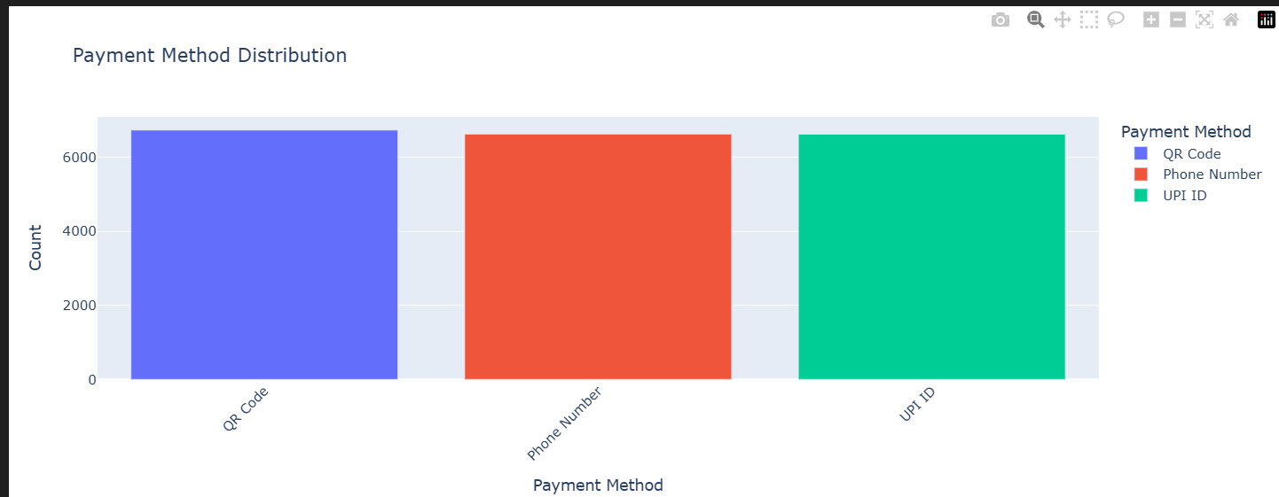
Payment Method Distribution
To analyze and visualize the distribution of different payment methods used by customers to identify the most and least preferred modes of transaction.
This helps in understanding customer preferences and optimizing future payment options for a better user experience and operational efficiency.

Slide 7
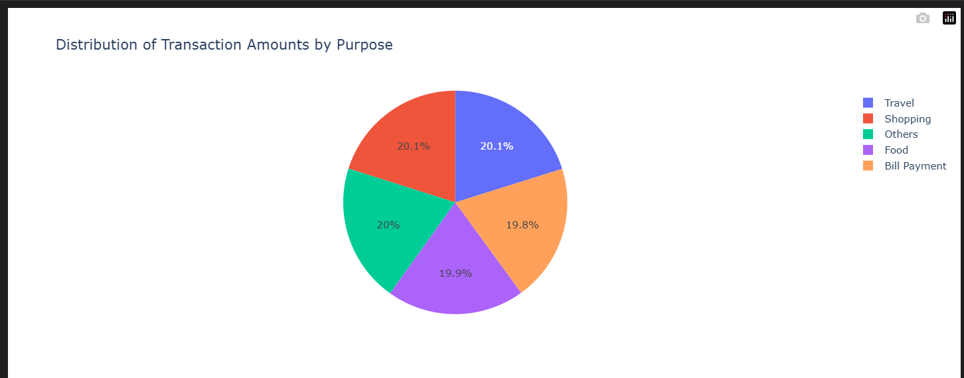
Distribution of Transaction Amounts by Purpose
To analyze how the total transaction amount is distributed across different purposes, helping to identify which spending categories account for the highest and lowest financial outflows.
This insight supports better budgeting, resource allocation, and understanding of user spending behavior.

Slide 8

Key Insights
Most Popular Payment Methods
Certain payment methods (like Google Pay or PhonePe) dominate UPI usage, indicating user preference and platform popularity.
Top Purposes by Transaction Amount
Categories such as ‘Bill Payment’, ‘Shopping’, or ‘Fund Transfer’ contribute the highest share of total UPI transaction value, reflecting user priorities.
User Behavior Patterns
A small number of users may contribute to a large percentage of the total amount, indicating potential power users or businesses.
Transaction Frequency vs. Amount
Some purposes (e.g., mobile recharges) may have high frequency but low average value, while others (e.g., rent payments) may have low frequency but high value.

Slide 9

Conclusion
Understand peak hours and most active days for digital payments.
Identify top-performing banks, frequently used merchants, and preferred device types.
Highlight the gender-wise and city-wise usage trends of UPI services.
Compare the success and failure rates of transactions to assess reliability.
Track user spending habits and transaction preferences (P2P vs P2M).

Slide 10


